Slide 1

Online Job Portal
Presented By: Amit Sundriyal
MCA Dept

Slide 2
Content
Introduction
Existing System
Propose System
System Requirement
Analysis Model
Database Schema
User Interface

Slide 3
Introduction
It provides facility to the Job Seeker to search for various jobs as per his qualification. Here Job Seeker can registered himself on the web portal and create his profile along with his educational information. Job Seeker can search various jobs and apply for the Job.
This Portal is also designed for the various employer who required to recruit employees in their organization. Employer can registered himself on the web portal and then he can upload information of various job vacancies in their organization. Employeer can view the applications of Job Seeker and send call latter to the job seekers.

Slide 4
Existing System
The present system requires applicants to search through print and visual media for job opportunities. Applicants need to apply for jobs using conventional methods and appear for interview on a specified date at a specified location. Employers need to advertise the vacancies and sort all applicant details, conducts election procedures and complete the formalities. This approach is tedious and requires much effort and resources.

Slide 5
Proposed System
The proposed system is a web based application which allows applicants and employers to register their details. Applicants can browse through the vacancy details that are posted and can apply for the jobs online. Employers can browse through the posted resumes and select suitable candidates.

Slide 6
System Requirement
SOFTWARE REQUIREMENT
Front End – HTML, CSS, Bootstrap, jQuery, Ajax.
Back End – Php
Database -MySQL
Server – Apache Tomcat 9
Documentation Tools – Microsoft Word
Web Requirements
Bandwidth – 1mbps(minimum)
Internet – 512 kbps(minimum)
Internet Explorer 8.0 or any browser

Slide 7
System Requirement
HARDWARE REQUIREMENT
Duel Core processor.
2GB MB RAM
30 GB Hard-Disk.
4x Compact Disk drive or quicker.
Monitor. [ 640 x 480 Display]

Slide 8
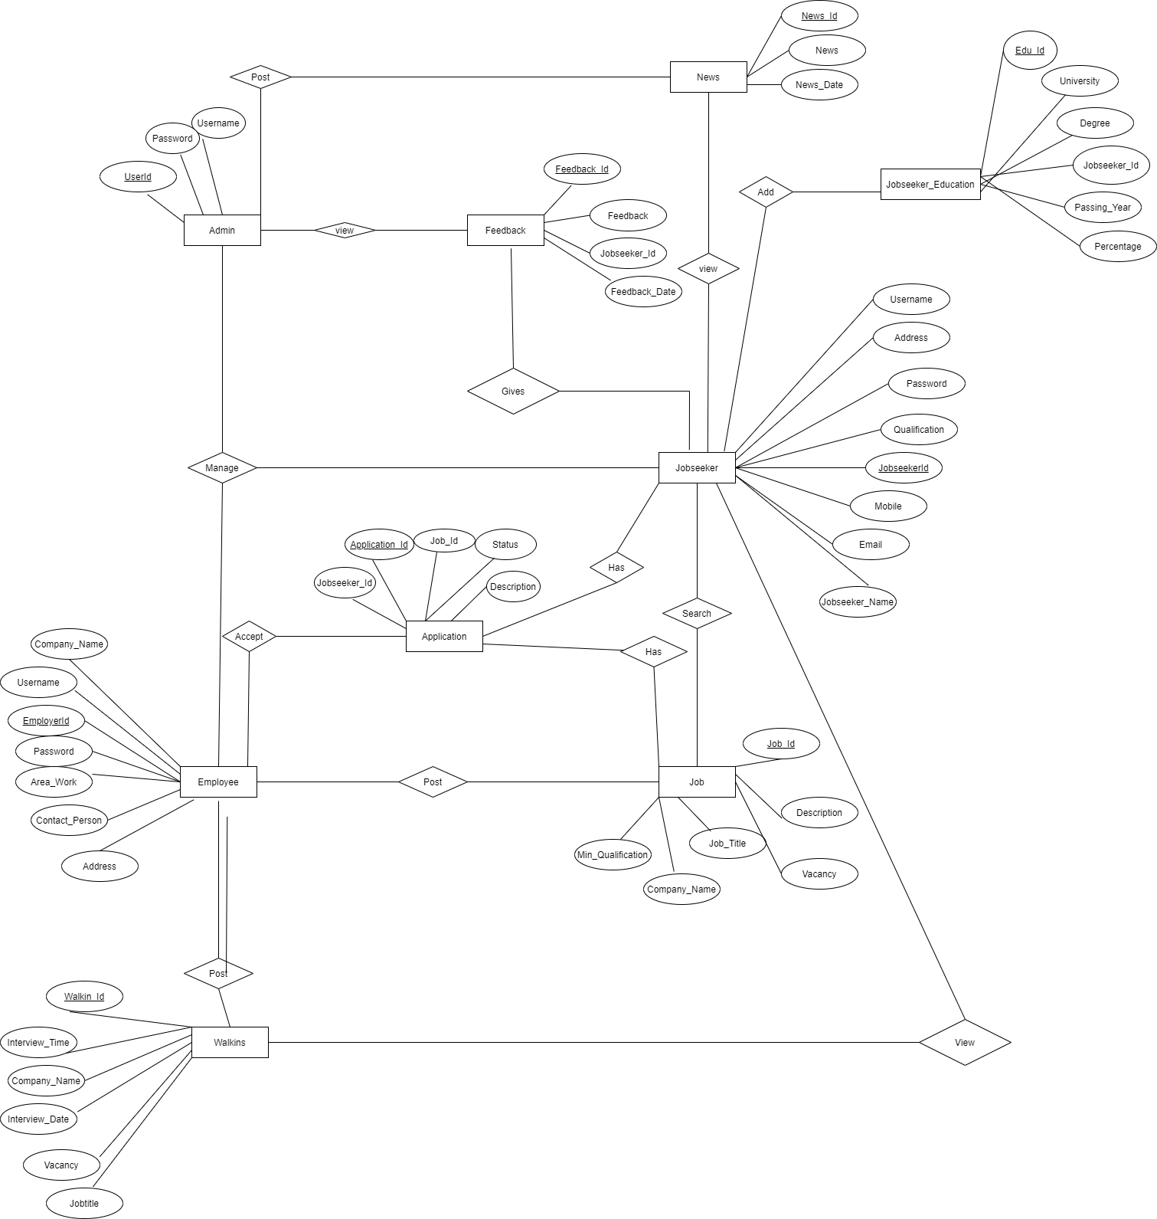
Analysis Model
E-R Diagram

Slide 9
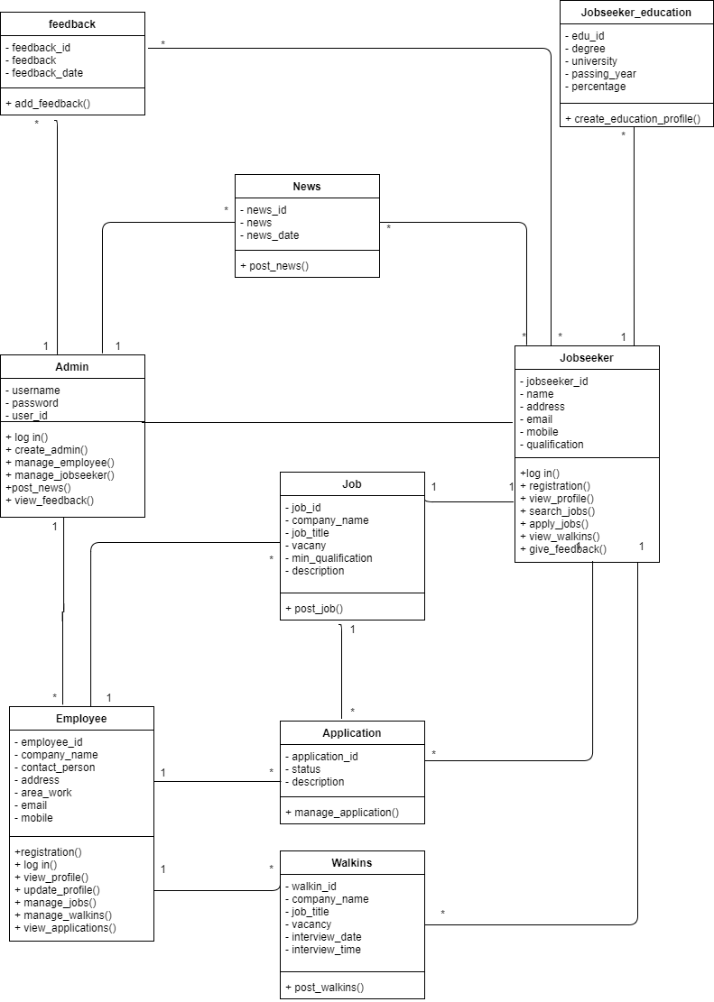
Class Diagram

Slide 10
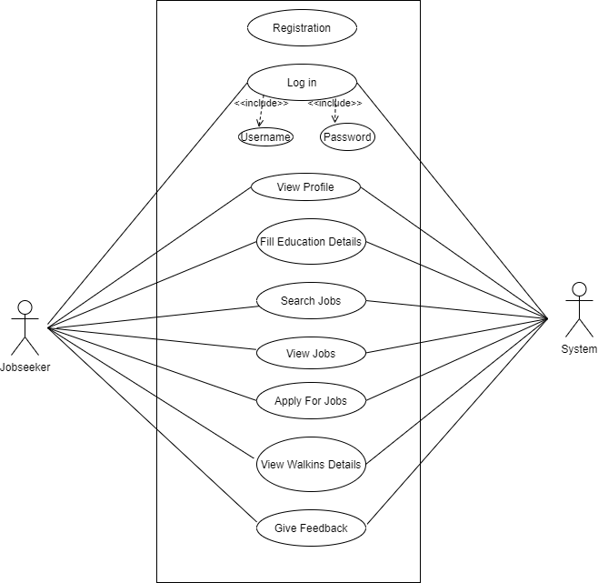
Use-case Diagram
Jobseeker_Usecase

Slide 11
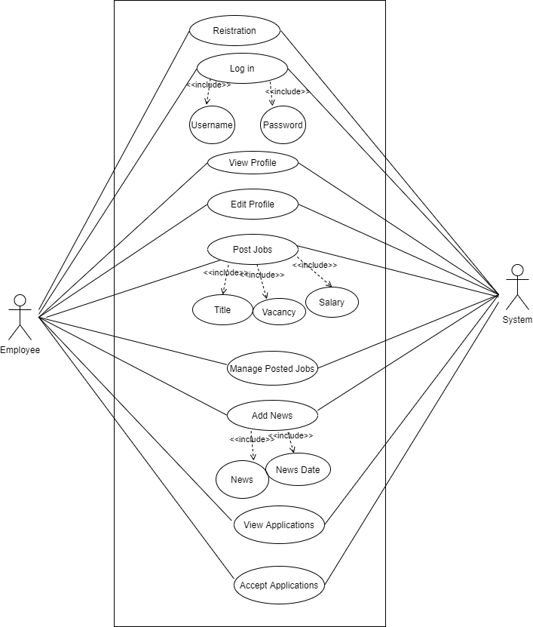
Employee_Usecase

Slide 12
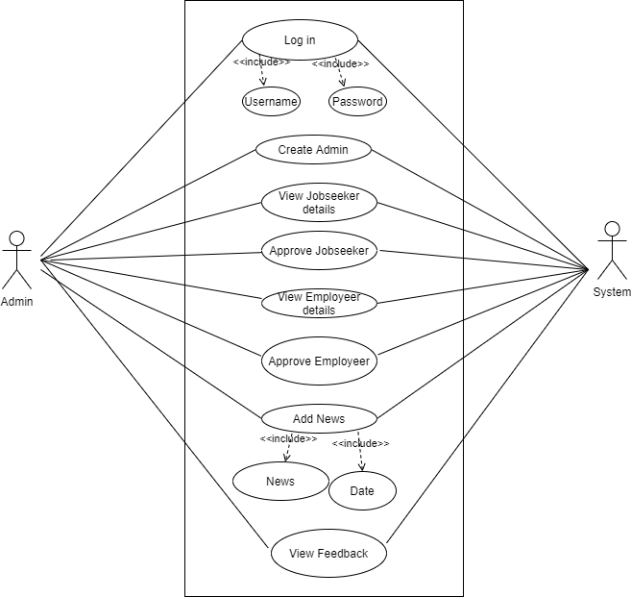
Admin_Usecase

Slide 13
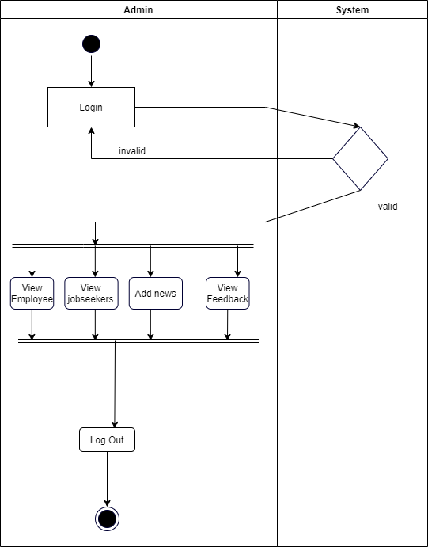
Activity Diagram
Admin_Activity

Slide 14
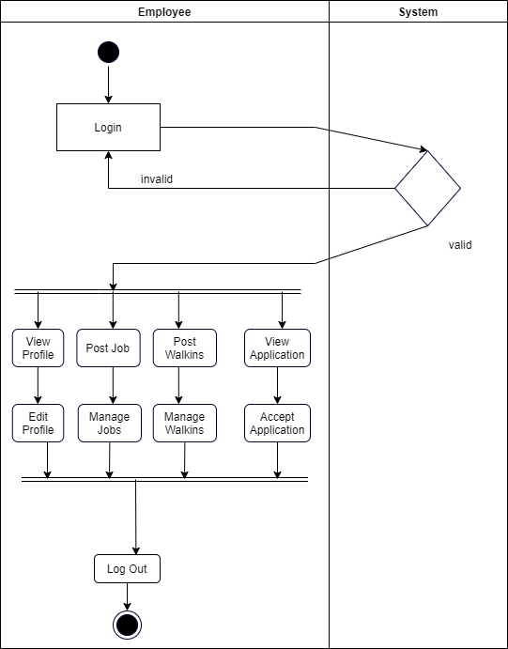
Employee_Activity

Slide 15
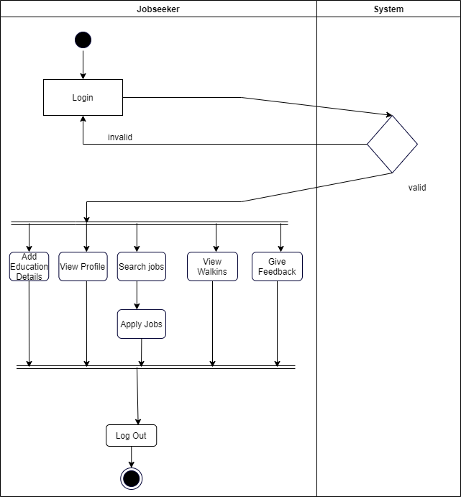
Jobseeker_Activity

Slide 16
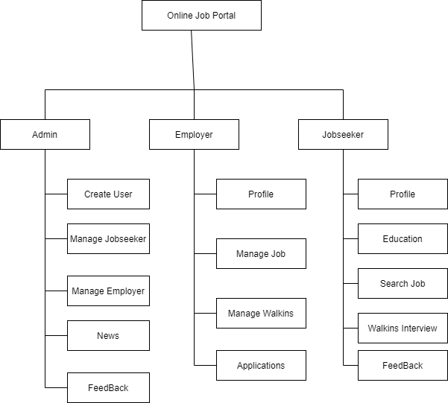
Module Hierarchy Diagram

Slide 17
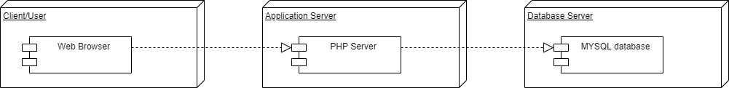
Deployment Diagram

Slide 18
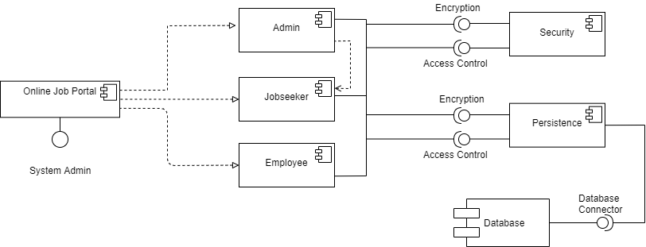
Component Diagram

Slide 19
Employee Table
# | Name | Type | Null | Constraint | Description
1 | EmployerId | int(11) | Not Null | Primary Key | Strore Employee id
2 | CompanyName | varchar(20) | Not Null | None | Store Company Name
3 | ContactPerson | varchar(20) | Not Null | None | Contact person of the Company
4 | Address | varchar(100) | Not Null | None | Address of the Company
5 | City | varchar(20) | Not Null | None | Store City Name
6 | Email | varchar(40) | Not Null | None | Contact Person;s Email
7 | Mobile | bigint(20) | Not Null | None | Contact Person;s Number
8 | Area_Work | varchar(40) | Not Null | None | Company’s Domain
9 | Status | varchar(10) | Not Null | None | Store Status
10 | UserName | varchar(20) | Not Null | None | Employee Username
11 | Password | varchar(20) | Not Null | None | Employee Password
12 | Question | varchar(100) | Not Null | None | Security Question
13 | Answer | varchar(50) | Not Null | None | Security Answer

Slide 20
Application Table
# | Name | Type | Null | Constraint | Description
1 | ApplicationId | int(11) | Not Null | Primary Key | Application id
2 | JobSeekId | int(11) | No Null | Foreign Key | Jobseeker id
3 | JobId | int(11) | No Null | Foregin Key | Job id
4 | Status | varchar(30) | No Null | None
5 | Description | varchar(200) | No Null | None

Slide 21
Feedback Table
# | Name | Type | Null | Constraint | Description
1 | FeedbackId | int(11) | Not Null | Primary Key | Store Feedback Id
2 | JobSeekId | int(11) | Not Null | Foreign Key | Jobseeker Id
3 | Feedback | varchar(200) | Not Null | None | Store Feedback
4 | FeedbakDate | date | Not Null | None | Store Feedback Date

Slide 22
Jobseeker’s Education Table
# | Name | Type | Null | Constraint | Description
1 | EduId | int(11) | Not Null | Primary Key | Jobseeker’s Education Id
2 | JobSeekId | int(11) | Not Null | Foreign Key | Jobseeker Id
3 | Degree | varchar(20) | Not Null | None | Jobseeker;s Degree
4 | University | varchar(100) | Not Null | None | Store University
5 | PassingYear | mediumint(9) | Not Null | None | Jobseeker passing year
6 | Percentage | float | Not Null | None | Jobseeker’s Percentage

Slide 23
Jobseeker Table
# | Name | Type | Null | Constraint | Description
1 | JobSeekId | int(11) | Not Null | Primary Key | Store Jobseeker Id
2 | JobSeekerName | varchar(20) | Not Null | None | Jobseeker’s Name
3 | Address | varchar(100) | Not Null | None | Jobseeker’s Address
4 | City | varchar(20) | Not Null | None | Store City Name
5 | Email | varchar(40) | Not Null | None | Jobseeker’s Email
6 | Mobile | bigint(20) | Not Null | None | Jobseeker’s Number
7 | Qualification | varchar(20) | Not Null | None | Jobseeker’s Qualification
8 | Gender | varchar(10) | Not Null | None | Jobseeker’s Gender
9 | BirthDate | date | Not Null | None | Jobseeker’s Birthday
10 | Resume | varchar(200) | Not Null | None | Jobseeker’s Resume
11 | Status | varchar(10) | Not Null | None | Jobseeker’s Registration Status
12 | UserName | varchar(20) | Not Null | None | Jobseeker’s Username
13 | Password | varchar(20) | Not Null | None | Store Password
14 | Question | varchar(100) | Not Null | None | Security Question
15 | Answer | varchar(50) | Not Null | None | Security Answer

Slide 24
Job Table
# | Name | Type | Null | Default | Comments
1 | JobId | int(11) | Not Null | Primary Key | Store Job Id
2 | CompanyName | varchar(20) | Not Null | None | Store Company Name
3 | JobTitle | varchar(50) | Not Null | None | Store Job Title
4 | Vacancy | int(11) | Not Null | None | Total Number Of Vacancies
5 | MinQualification | varchar(50) | Not Null | None | Minimum Qualification Requried
6 | Description | varchar(200) | Not Null | None | Extra Information related to the job

Slide 25
News Table
# | Name | Type | Null | Constraint | Description
1 | NewsId | int(11) | Not Null | Primary Key | Store NewsId
2 | News | varchar(200) | Not Null | None | Store News
3 | NewsDate | date | Not Null | None | Store News Date

Slide 26
Admin Table
# | Name | Type | Null | Constraint | Description
1 | UserId | int(11) | Not Null | Primary Key | Store Admin Id
2 | UserName | varchar(20) | Not Null | None | Admin’s Username
3 | Password | varchar(20) | Not Null | None | Admin’s Password

Slide 27
Walkins Table
# | Name | Type | Null | Constraint | Description
1 | WalkInId | int(11) | Not Null | Primary Key | Store Walkin Id
2 | CompanyName | varchar(20) | Not Null | None | Store Company Name
3 | JobTitle | varchar(50) | Not Null | None | Store Job title
4 | Vacancy | int(11) | Not Null | None | Total Vacancies
5 | MinQualification | varchar(50) | Not Null | None | Minimum Qualification Required
6 | Description | varchar(100) | Not Null | None | Extra Job Requriment
7 | InterviewDate | date | Not Null | None | Walkin Date
8 | InterviewTime | time | Not Null | None | Walkin Time

Slide 28
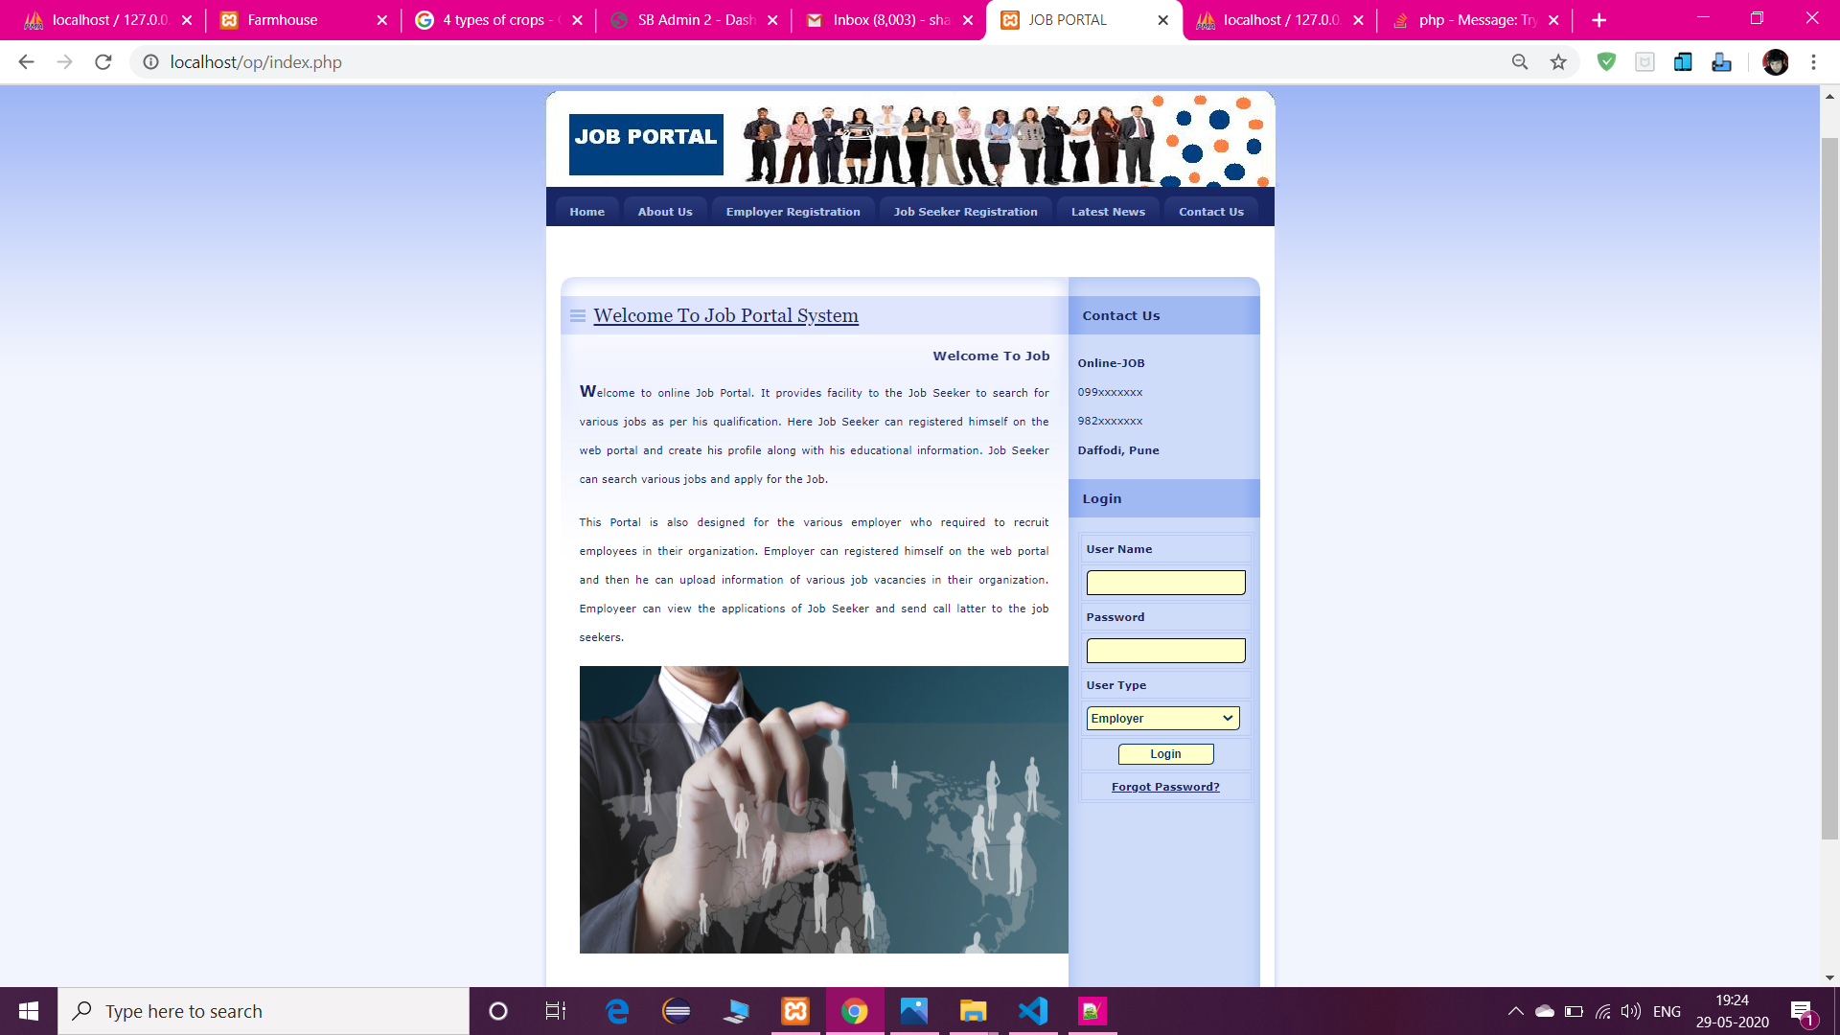
User Interface
Login Page:

Slide 29
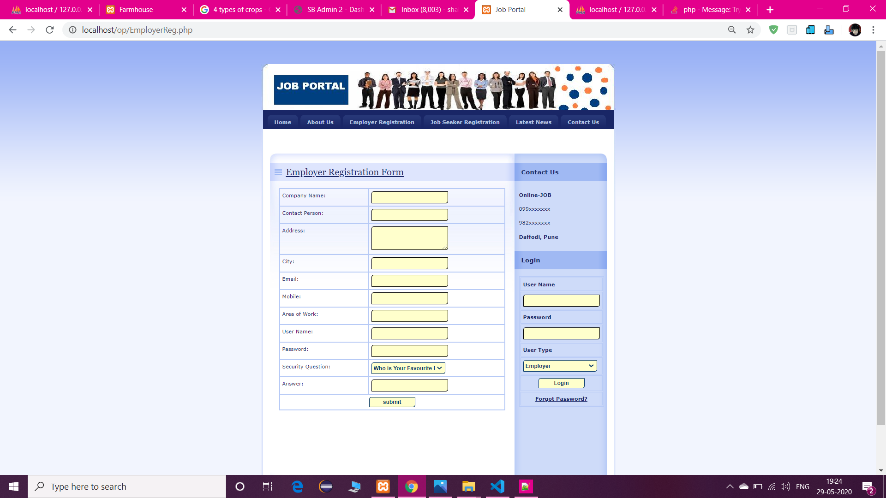

Slide 30
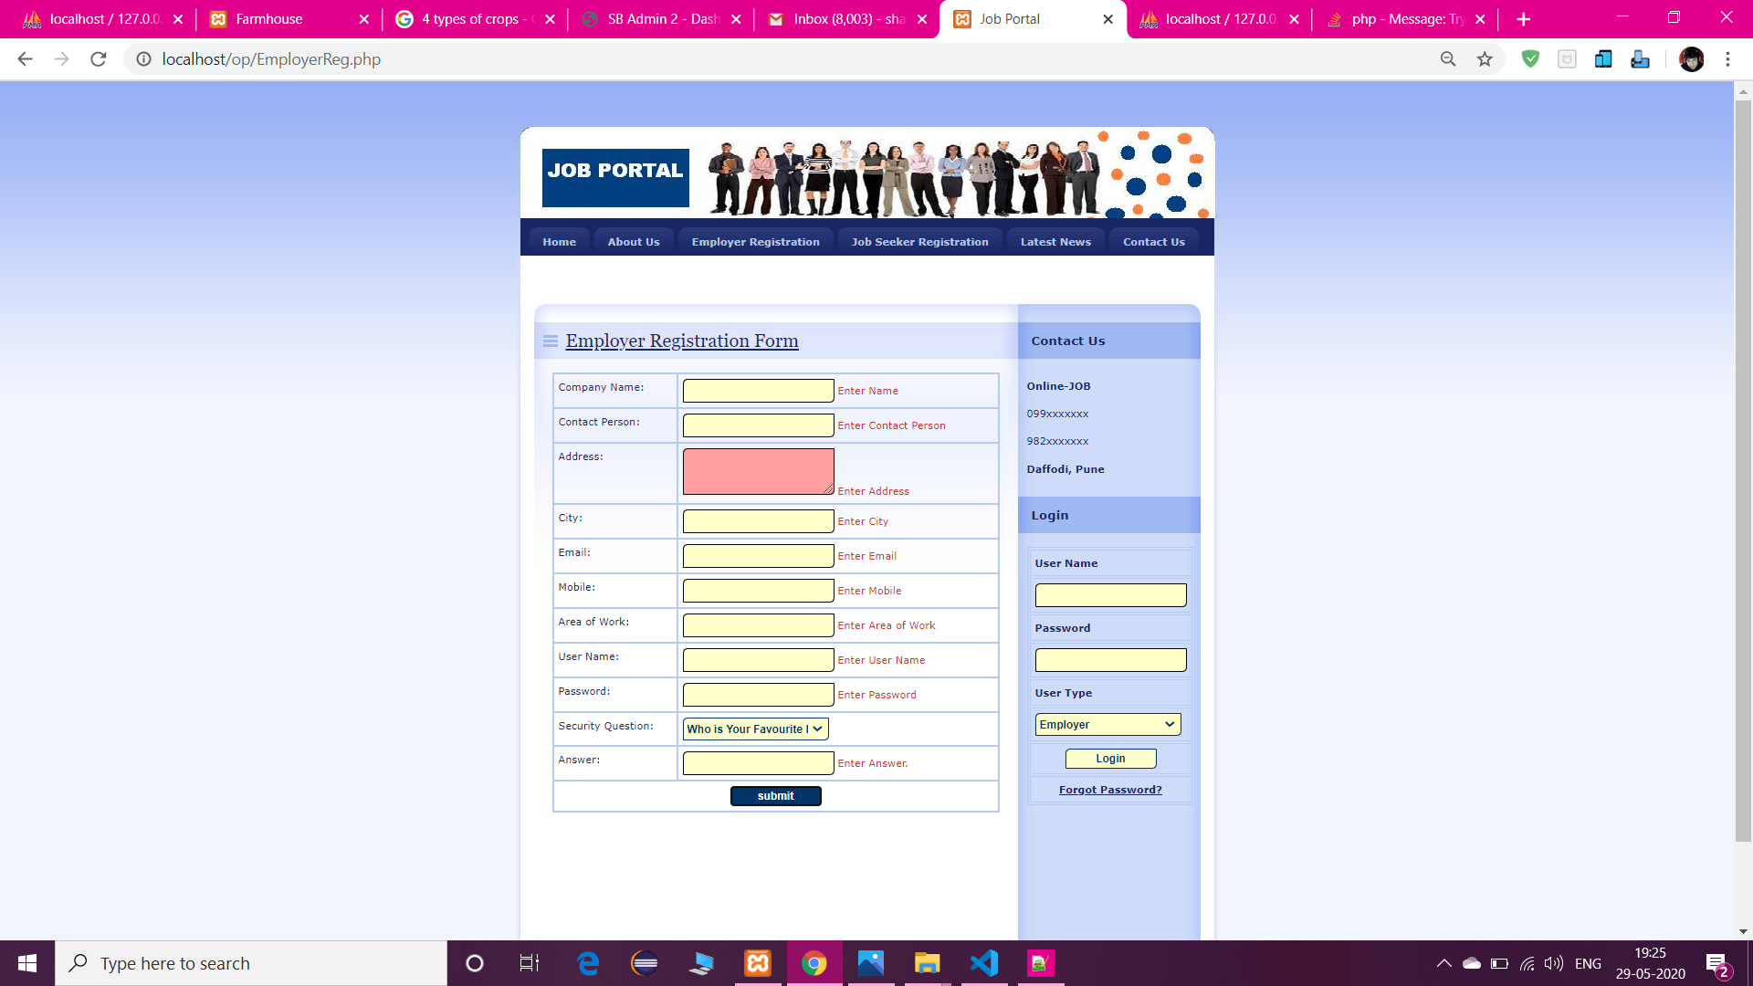

Slide 31


Slide 32
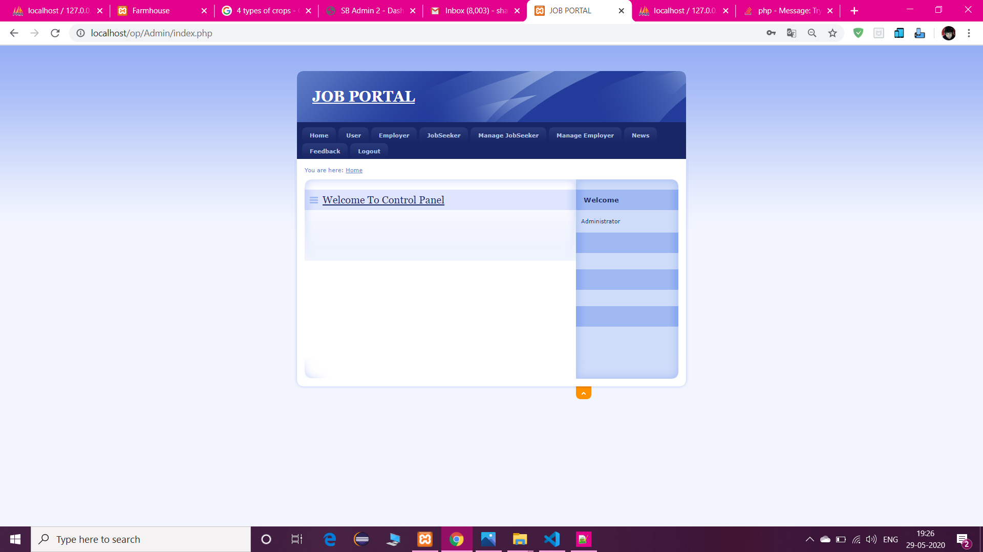

Slide 33
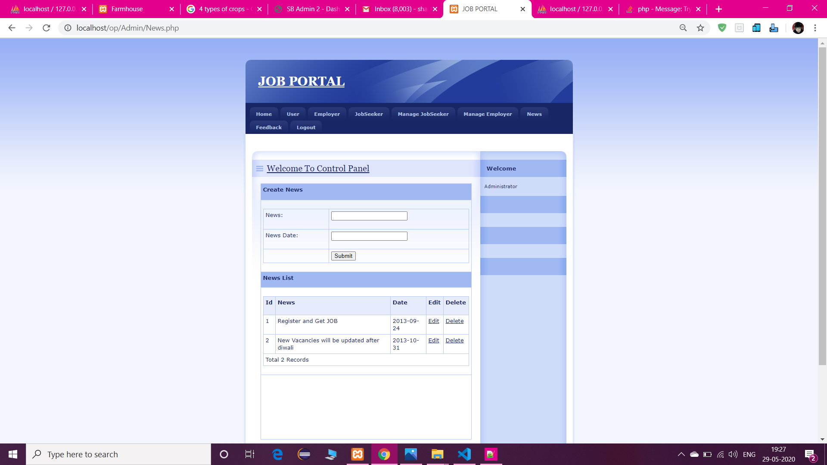

Slide 34
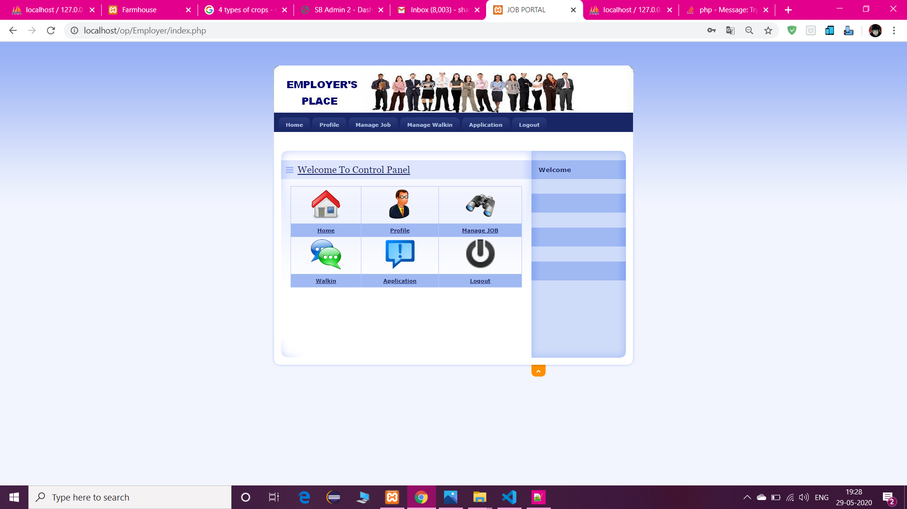

Slide 35
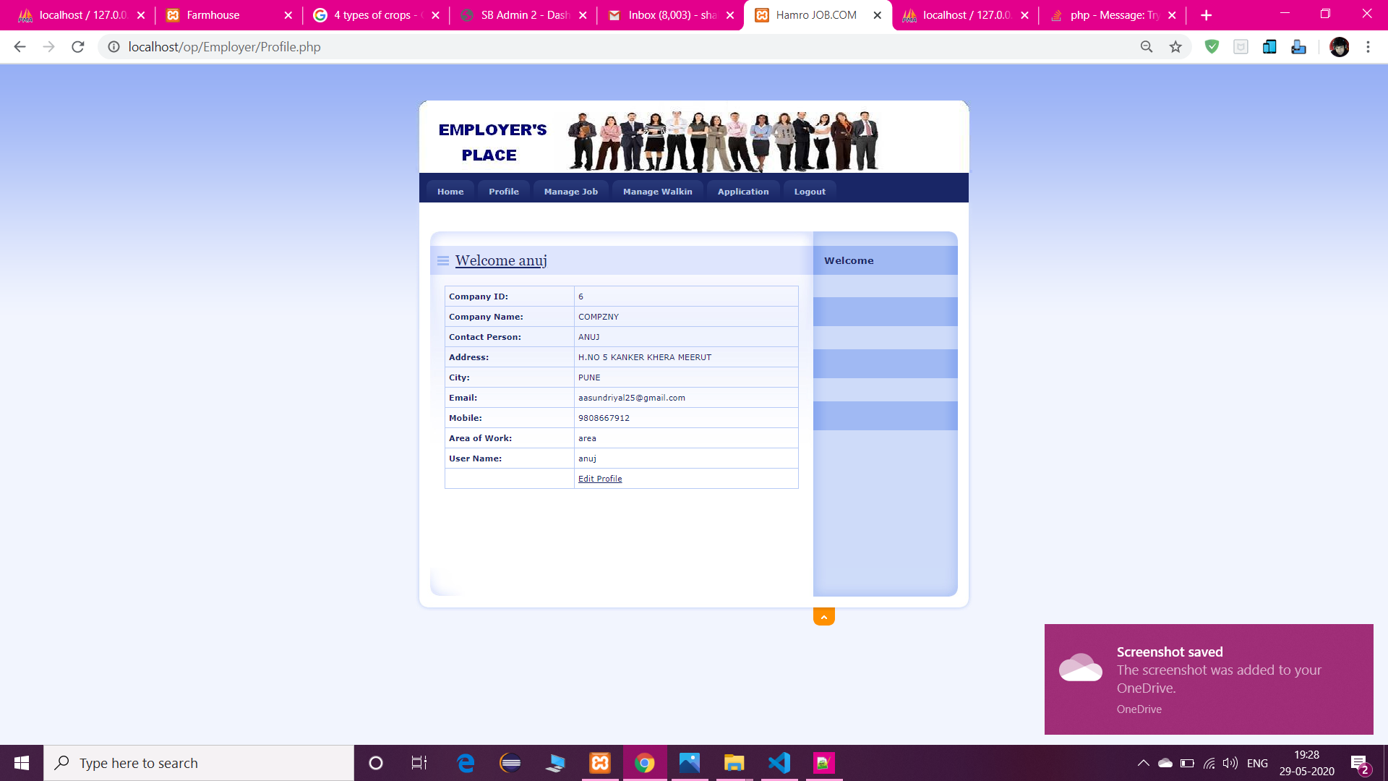

Slide 36
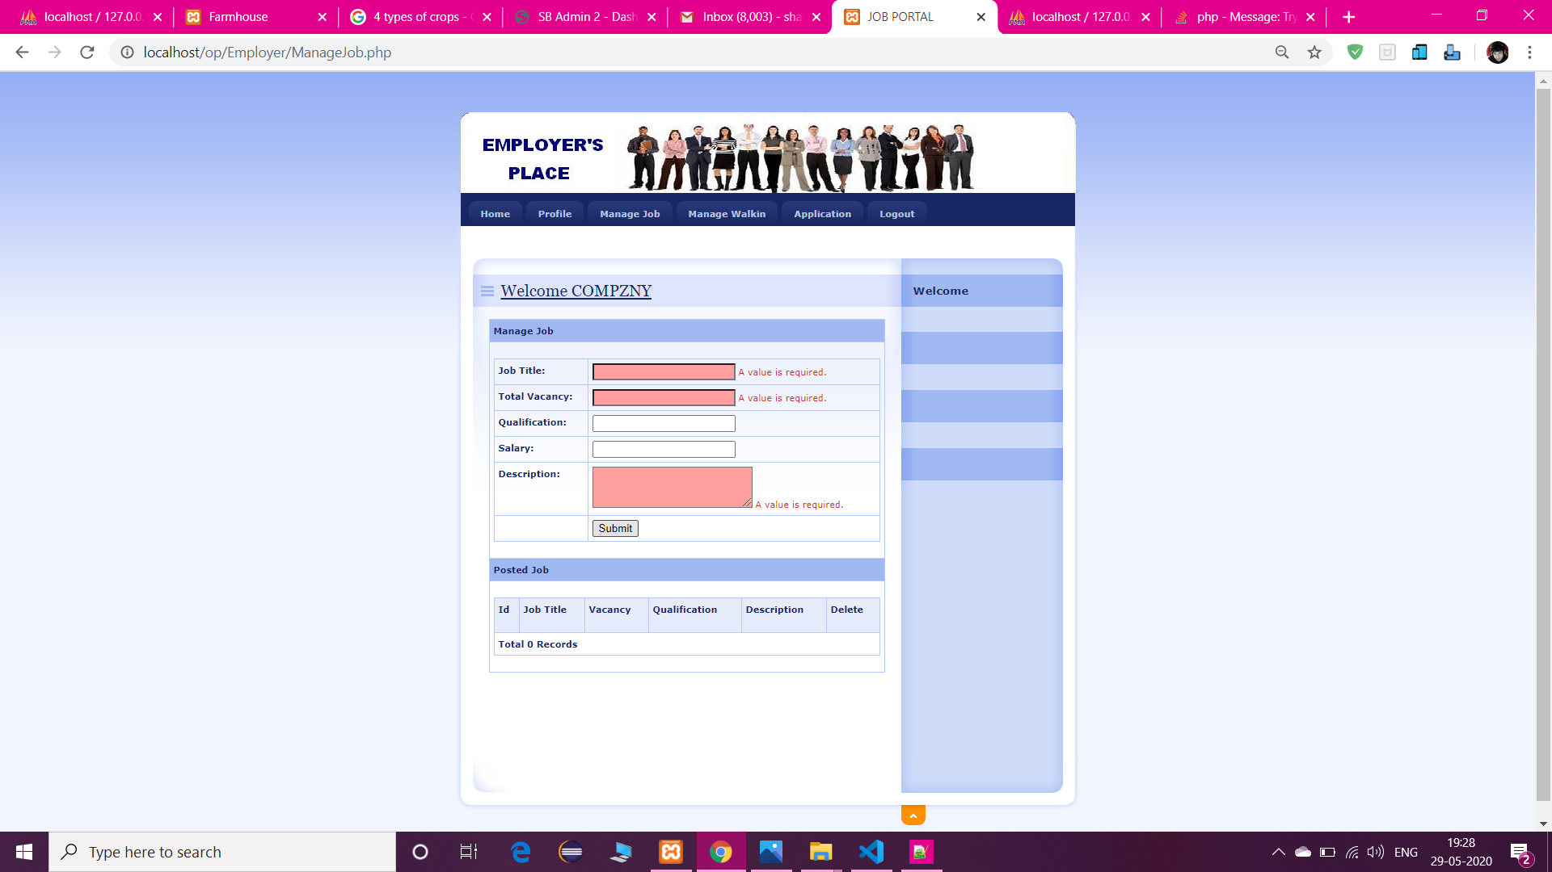

Slide 37
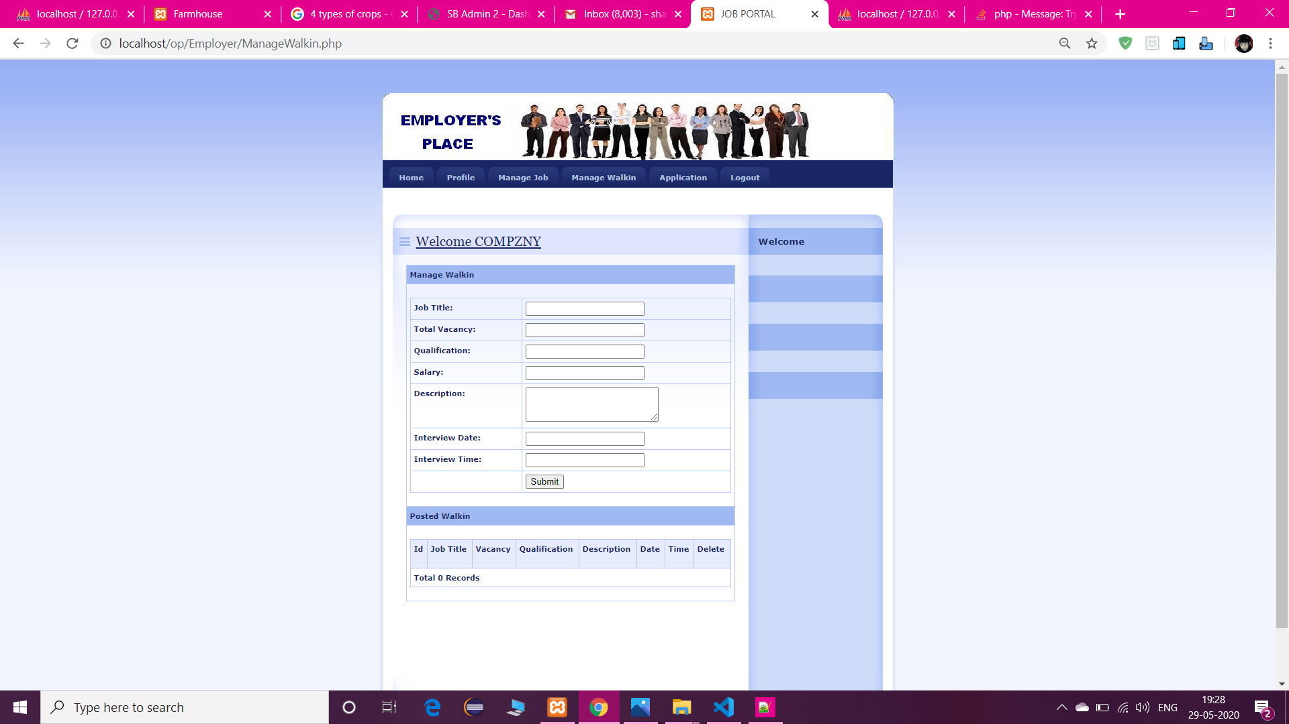

Slide 38
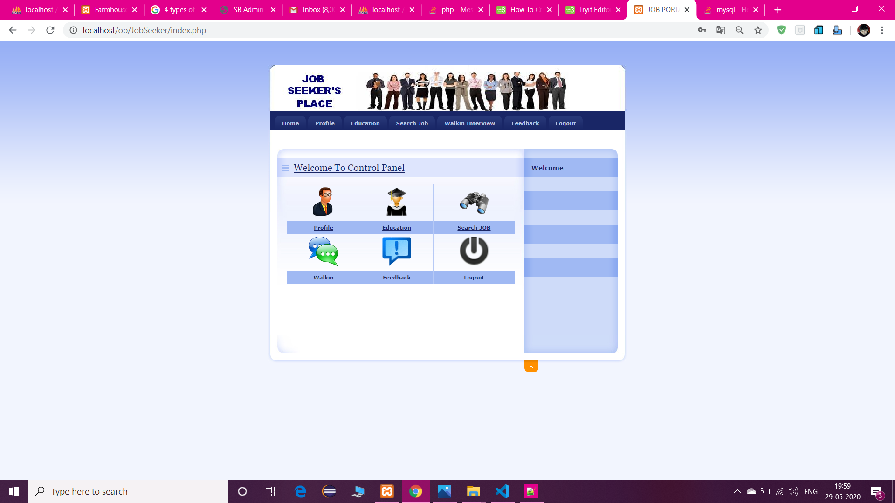

Slide 39
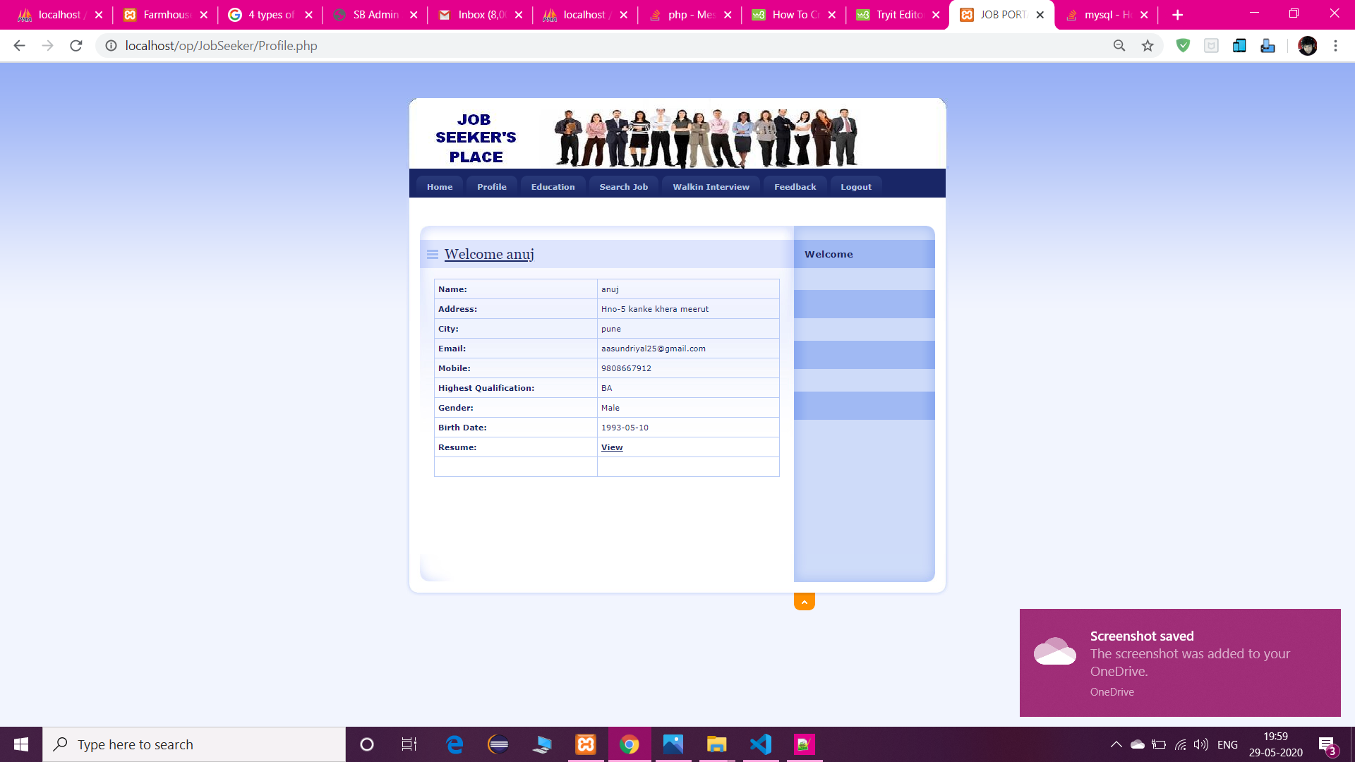

Slide 40
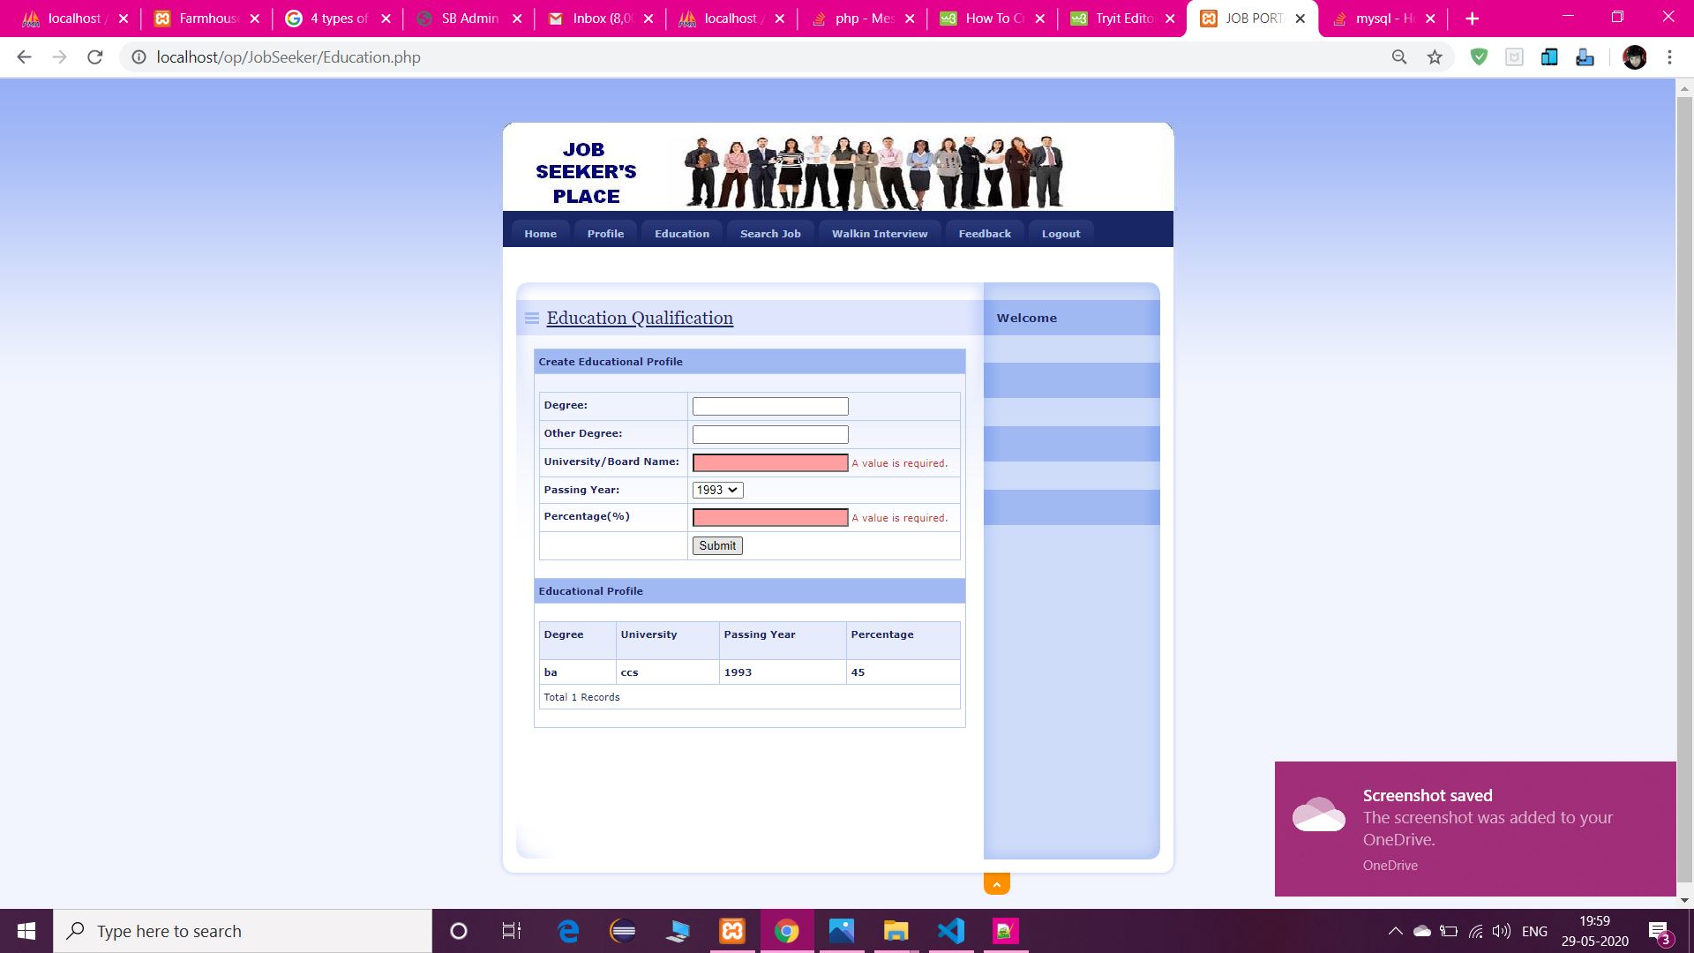

Slide 41
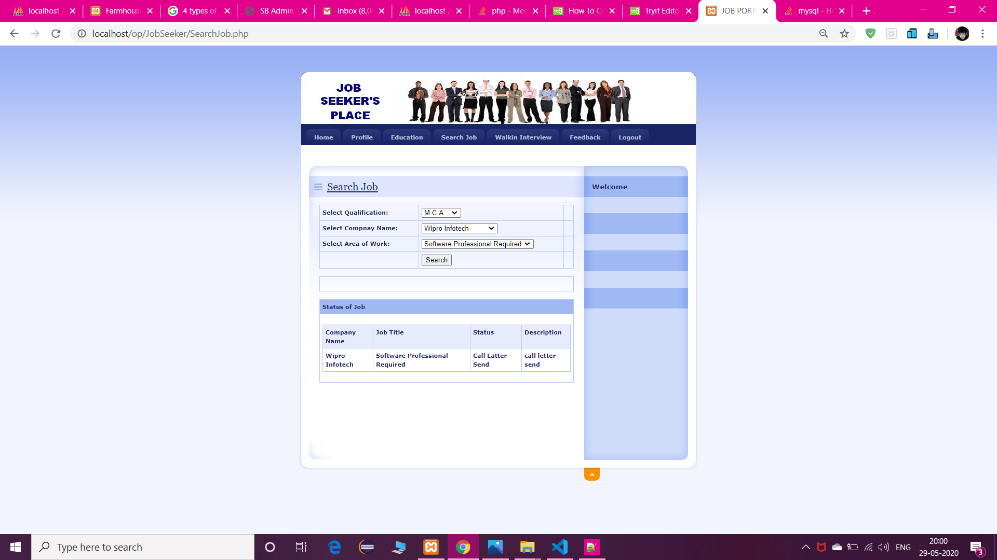

Slide 42
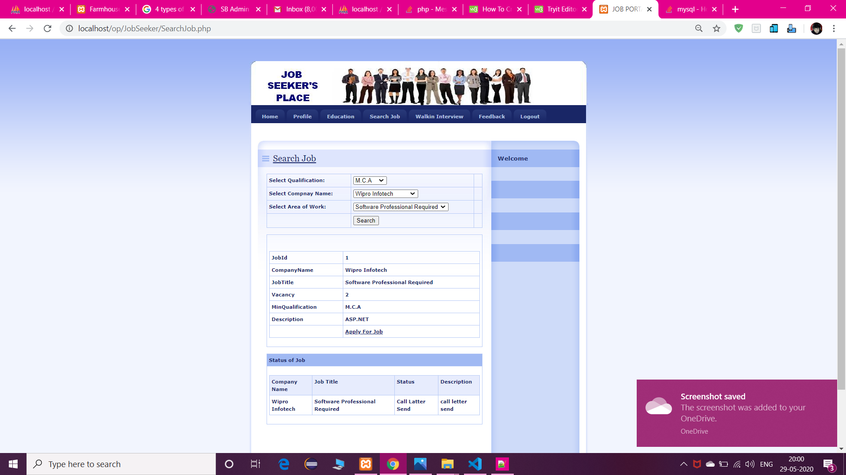

Slide 43
